Slide 1

Feedback from 29th and 30th November 2023
Moller Centre, Cambridge

Slide 2
Overall Value of the meeting: Max 7, Min 1

Slide 3
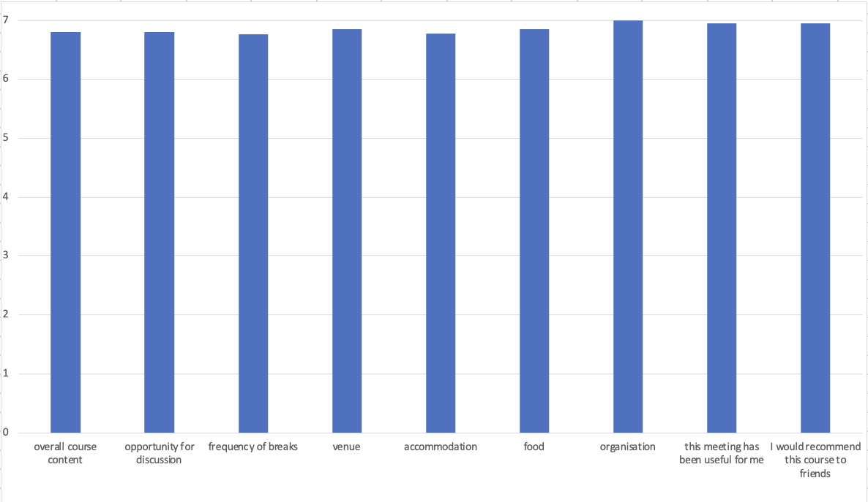
All aspects of meeting: Max 7, Min 1

Slide 4
Speaker Scores: Max 7, Min 1

Slide 5
General Comments
Excellent Course
Superb venue. Very comfortable
Great course. Great food. Great venue. Great accommodation and organization. Teaches you almost everything you want or need to know for Consultant life but never get told in training
Superb course. All great. Very useful Introduction to expect a consultant practice that one doesn’t normally see or experience as a trainee and how to manage them
Excellent course. Learned a lot of very useful info. Very interactive. Tasty food. Excellent accommodation. Absolutely brilliant organisation
Superb course. Great food
Love the venue. Amazing food. Could have been more scope for discussion. While it doesn’t affect my perception of the course, I feel there could be more diversity in the faculty
Excellent course content. Good refreshments. Excellent organisation
Excellent overall course content, clear and useful. Very good venue and food. Accommodation much better than expected. Stuck to timetable as advertised
Excellent all encompassing course with lots of points not covered elsewhere
Great course with lots of information and guidance

Slide 6
How would you describe this course to somebody who knows nothing about it?
A broad introduction to Consultant life. Insightful re-job plan and finances.
You didn’t know you needed to know to prepare for Consultant practice.
. Excellent course with a lot of very useful advice about broad subjects including work life balance and advice insight that no one else would share with you.
An incredibly useful, engaging and supportive of course which provides excellent skills and frameworks in dealing with issues of leadership, communication, and daily life in one’s medical career. Come and learn what no one else will, will have time, to teach you.
Gives you an understanding/ foundation in aspects of consultant jobs that we often don’t get much teaching or training about previously just learned on the job
Fast paced calls with excellent speakers and positive engagement from candidates and faculty. Some physical activity which was welcomed.
Must attend: eye-opening
Provides a wealth of information that I never realized I needed to know as a senior medical Trainee. Detailed but easily accessible course on leadership and management with an engaging and knowledgeable faculty
Best value for money, inspiring speakers and ticking all the boxes for a great course.
Excellent course in preparation for life is a new consultant and beyond. All the information that no one tells you.
Although the course is run by surgeons and Rosie attended by surgeons it’s actually relevant to all medical specialties Great mix of leadership theory and ideas to put into practice with more practical aspects of becoming a consultant

Slide 7
Why would you recommend this course to a colleague?
Yes. Really enjoyed. Great faculty. Interesting, engaging, relevant. Very reasonably priced.
Addresses the hidden curriculum of management and private practice.
Content not found in other courses. What you need to know.
Amazing speakers and great value of information. Very interactive and fun. Absolutely recommend this course as great faculty, knowledge and organization. Very useful information that is applicable in all aspects of personal and professional life.
The eye doesn’t see what the mind doesn’t know. I didn’t know any of this so I never thought about asking about them.
Absolutely, very good info
Because I got so much out of it myself
Best course I attended for management and leadership
Decent venue with excellent food and accommodation
Better understanding of private work
This was the best course in terms of content organization and venue “the iPhone in courses compared to the rest” Excellent faculty, venue and content Absolutely Great speakers, good atmosphere, fun and educational

Slide 8
Comments from delegates: What was most useful
Leadership Workshops 1 and 2: Richard Canter
Understanding personality types, negotiating framework. Workshop 1 went through everyday scenarios.
Understanding personality types and how to interact. And, not but. Inspire-focus-enable-reinforce-learn
Very encouraging start to course. Set the tone for the environment Excellent heuristics that I will aim to use in everyday life
Eye opening talks on managing people. Definition of leadership Working out my working style, How to frame difficult conversations
Tools for communication and negotiation. Leadership domains. Personality types.
Excellent perspective about recreating ourselves and leadership strategies Great speaker with so much work and life advice and job interview tips
Ways to deal with difficult conversations. Understanding the different components constituting good leadership
Different work styles and what this means in the workplace
Communication framework to use. Workshop 2: inspiring stories
Good insight into personality traits. Negotiating techniques. Passionate delivery.
Inspiring and fun. Workshop 2: Fantastic. Another great talk by Prof. Excellent tips and astonishing examples.

Slide 9
Business Planning in Urology: Ben Turney
To understand approach
Exposure to the process and complexity of building a business case
Insightful talk about things we take for granted Getting an idea of how to go about a business plan
Very useful information nobody cares to explain in detail What is involved in writing a business case and how to find out more information locally
Whole process. Not my speciality but still relevant
Great insight into what to expect in consultant life
It gives you a good idea about how to do a business case
Very useful eye opener to this topic
Very useful. Appreciate the step by step guidance
Comments from delegates: What was most useful

Slide 10
Working with industry: a physician’s perspective. Oliver Wiseman
Very useful to see another career perspective
Areas to be cautious of: ie: dependence
Awareness and keeping an eye out for opportunities to work with industry Always weary about working with industry, but this helped clear a lot of fears
Discussing the relationship between physician, industry, work and research and the ethical implications Great insight
Different perspective and how to get into it
Great presentation. Learned a lot about different ways to interact with industry
It tells you what kind of a person you are and your colleagues as well
Again, touching on a topic not covered much
Price of industry rate per day
Comments from delegates: What was most useful

Slide 11
Zero-net NHS: Ted Almond
Very important but a tad dry
Interesting ideas on sustainability and how companies are actually “greening”
Didn’t think the level of detail was needed for us
Good to see acknowledgement of carbon offsetting as “greenwashing” from industry Appreciating how reducing carbon impact must be done at a system / organizational level
Made me more aware of sustainable practice Interesting to hear about the environmental aspect of healthcare provision
It gives you a good idea about how big companies work and goals in next few years and challenges
Environmental impact of healthcare and things we can do to address it
Comments from delegates: What was most useful

Slide 12
Challenges of obtaining new equipment: Fred Dale
Showed the granular detail of getting kit
How service contracts work
Understanding the steps involved in procuring / introducing new equipment to a department Different ways of financing equipment
Difficult to contextualise the different contracting methods Not my speciality, but still relevant to practice
A tad dry
Understanding different contracts for equipment
Comments from delegates: What was most useful

Slide 13
Job planning, appraisal. Oliver Wiseman
Very useful to understand PAS and their distribution
PA allocation and avoiding extra PAS for no benefit
First time hearing about how a job plan works and what exactly the time segments are
Very useful in planning ahead For job interview practice
Understanding prioritization of job and life’s responsibilities Appreciate the job plan he shared with us and the details we need to know
How to job plan. Don’t be in the hospital is you do not need to be
The whole lecture
Good insight into how it all works and potential pitfalls
How to have a good job plan
Understanding PAs
Insight into PA system and advice for new consultants
Comments from delegates: What was most useful

Slide 14
Time Management and additional roles: Ben Turney
Personal value index
Importance of balance and self improvement
Understanding valuing one’s own time and what can be done with it Helped put a lot of things in perspective
How to put a value on time Prioritisation Great advice given
Building ”me time” into your week
Gave me more of an idea of what I can and cannot do
It gives you an idea of the additional roles
Understanding value (or lack of) of additional PAs
Comments from delegates: What was most useful

Slide 15
Complaints: Ben Turney
Very useful to understand approach to this and offering to meet the patient
Offering to speak in person
What are the processes of dealing with complaints and the logistics of it Settled anxieties about complaints
Knowing how to manage complaints both logistically and emotionally Normalised complaints process
Process of dealing with complaints and how to try and avoid them
Useful tips
Very useful session
Good general approach to a common issue
Comments from delegates: What was most useful

Slide 16
Managing Uncertainty: Oscar Lyons
Useful pauses
How to deal with stressful situations
Good talk but difficult to engage at end of day when tired List prioritisation
Excellent speaker. Excellent talks and lots of take home messages Developing tools of self awareness and situational awareness
How to defuse hostile situations
Useful in highlighting models of dysfunctional momentum and relational pauses
Great Talk
Comments from delegates: What was most useful

Slide 17
Avoiding burnout: Oliver Wiseman
Work life calendar
Work life balance and take acre to focus on health and exercise
Necessary part of having a successful career, life and health
Reassured that I should prioritise “me”
Recognising burnout in myself and colleagues and knowing how to support them
Important topic that is often not discussed openly
Very honest
Recognising what is important to you and how to divide over three buckets
Things to focus on yourself: happy, health, personal life
Comments from delegates: What was most useful

Slide 18
Setting up in private practice: Oliver Wiseman
Collaborative working in groups. How much you can actually earn
Insightful
A difficult area to get information on, so this was a useful talk Everything: completely new territory
Very useful as no-one else would share this detail How to balance private and NHS work
First time actually hearing about and understanding how PP works
Insurance, pay, set-up
Very useful as we never get an info about this in daily work / teaching
What to avoid in private practice
Really useful to know actual figures
Very generous sharing this information with us
Comments from delegates: What was most useful

Slide 19
Private practice: how can your accountant help? Vanessa Sanders
Clear and very informative
Very informative
Insights into types of company Eye opening and entertaining
Better understanding of claiming expenses Brilliant talk. So well delivered and useful
Great speaker
Excellent. Good pieces of information. A lot to take in
Difficult financial concepts explained
The nuances of setting up companies
Knowing about the thresholds for tax brackets and how to make things more tax efficient
Great overview. Ability to ask questions.
Comments from delegates: What was most useful

